Slide 1
Smart Office Network Using IOT Devices

Slide 2
Contents
Introduction
Computer Configuration
SMTP Configuration
DNS Configuration
FTP Configuration
Serial & FastEthernet Configuration
Routing RIP Configuration
Result
Controlling with Smartphone
Coding for Fire
Coding For Controlling Security
Pairing for Portable Music Player
conclusion

Slide 3
Introduction
A smart office monitoring system is to be considered with one entity in mind that is of full probable of workforce.
It’s not rocketry just innovative thinking and new technology that best fits people’s needs.
Office monitoring among other things facilitates easy documentation and real time communication. Smart office monitoring system complete on lighting, door-access, room controlling, fire detection, and SMTP, FTP, Routing is construct for the security and promote the satisfactions of the employees.

Slide 4
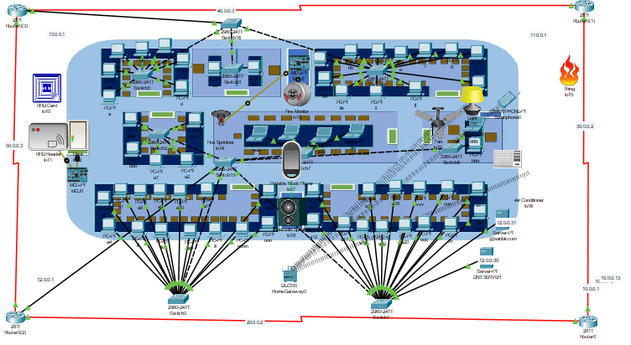
Overall Scenario

Slide 5
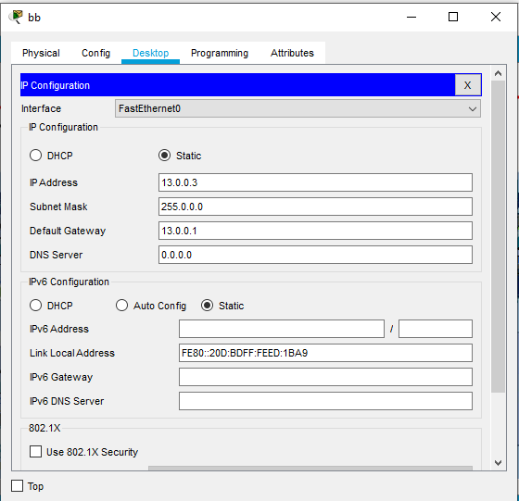
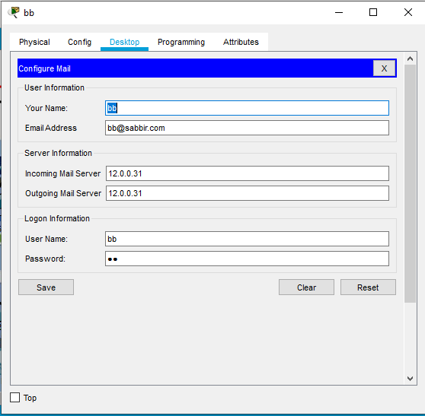
Computer Configuration

Slide 6
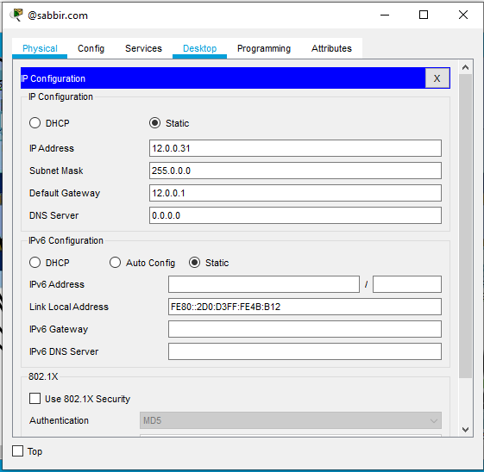
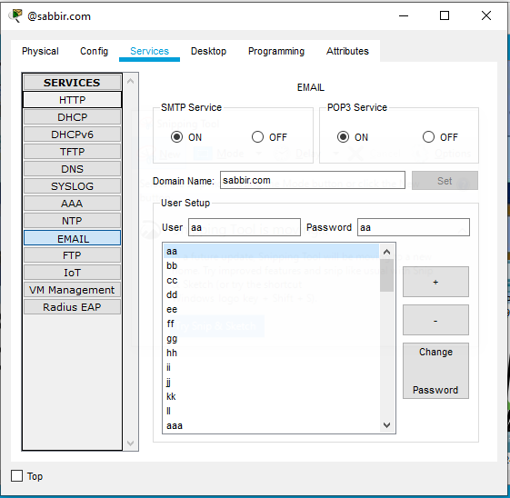
Mail Configuration

Slide 7
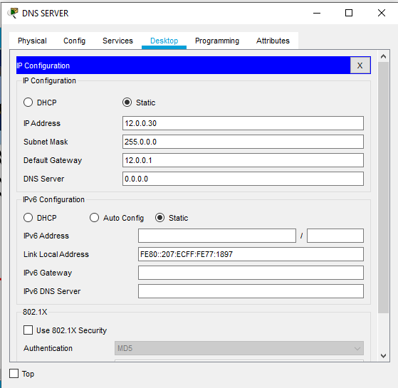
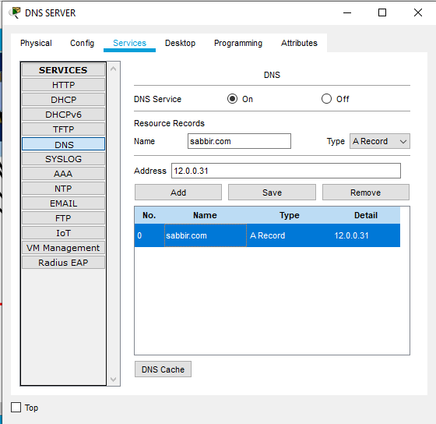
DNS Configuration

Slide 8
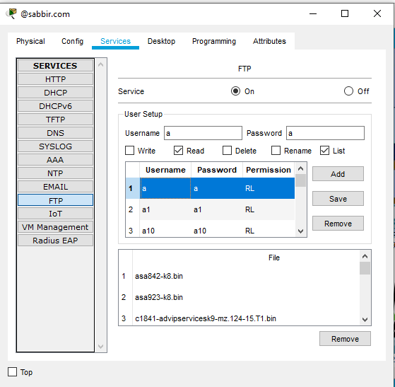
FTP Configuration

Slide 9
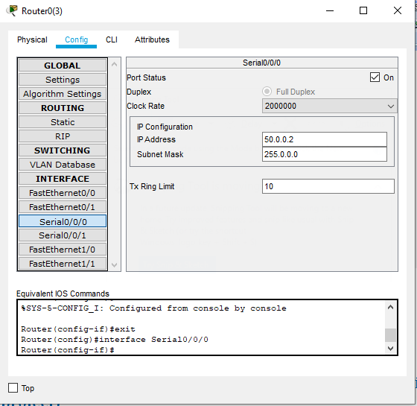
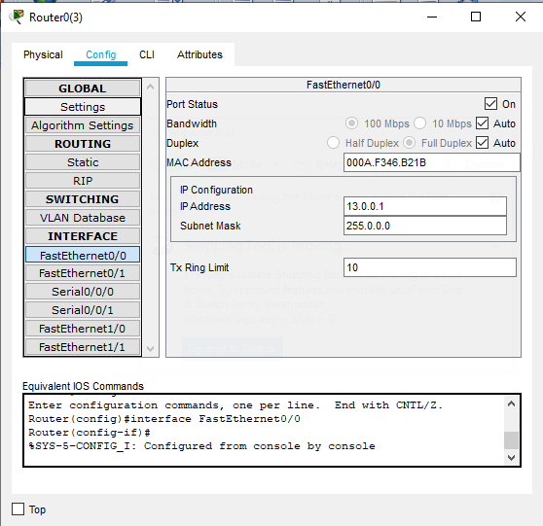
Serial & FastEthernet Configuration

Slide 10
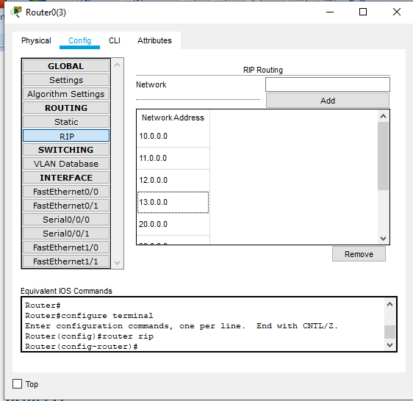
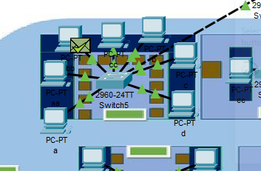
Routing RIP Configuration

Slide 11
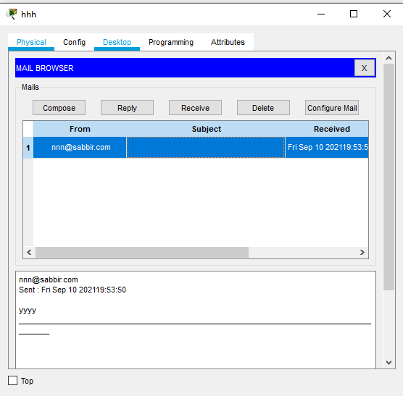
Message Success Checking

Slide 12
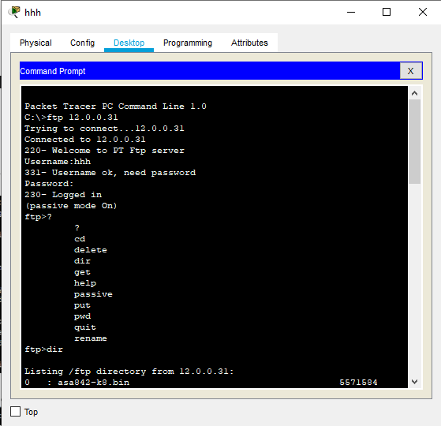
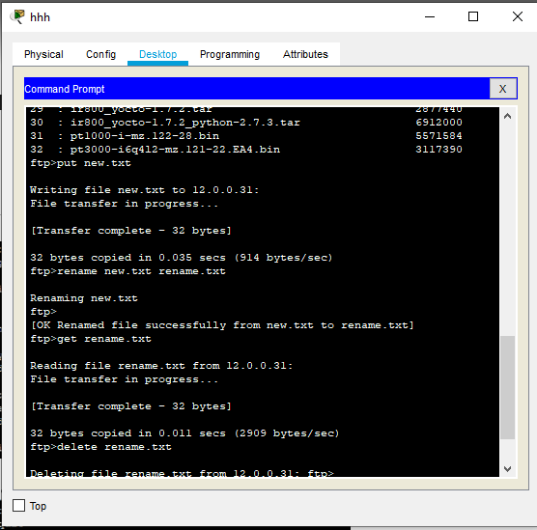
FTP Output

Slide 13
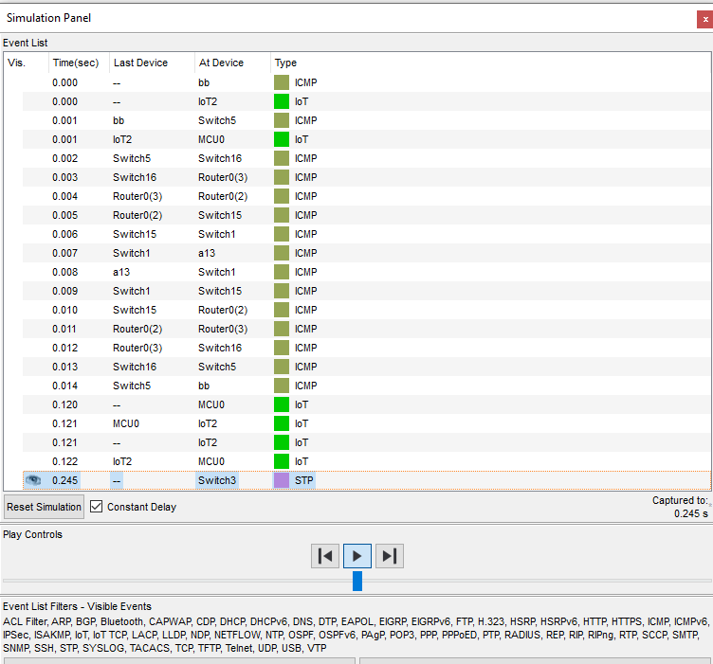
Simulation of Routing

Slide 14
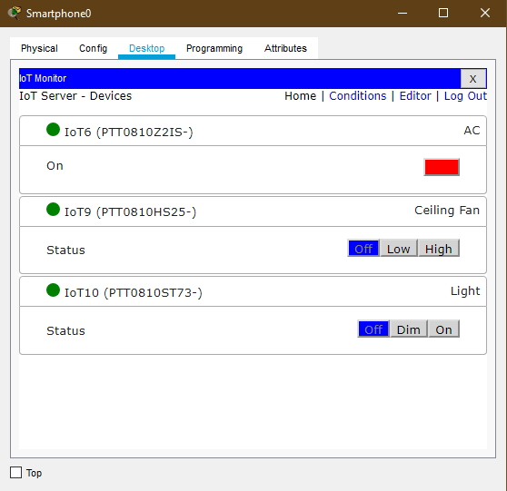
Controlling with Smartphone

Slide 15
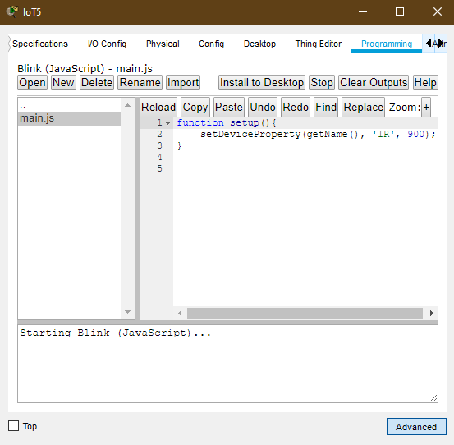
Coding for Fire

Slide 16
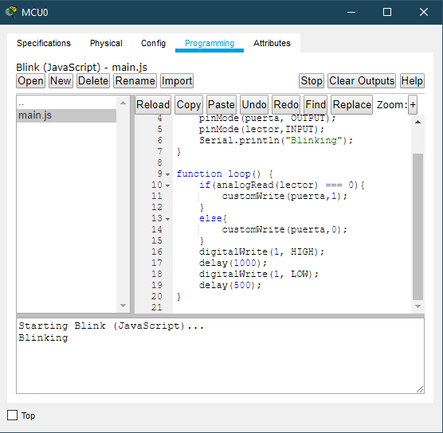
Coding For Controlling Security

Slide 17
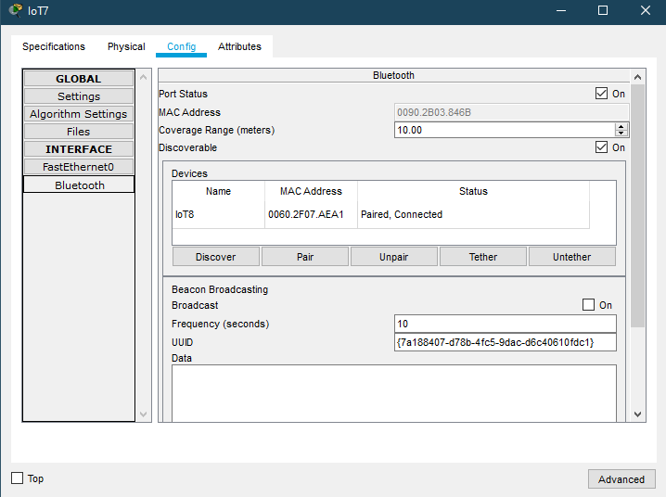
Pairing for Portable Music Player

Slide 18
Conclusion
During the implementation of these protocols, the main problems we have encountered are,
Each and every small step should be thoroughly examined. Otherwise, errors may be found requires a lot of time and patience.
So, we didn’t take too many numbers keep connections and projects simple.
However, it may be possible to implement it. It turns into a large network and gains benefits.

Slide 19


Be Safe & Get Vaccinated ASAP

